Slide 1

Grocery Buddy
By Ecoders (Patrick, Raly, Kevin, Toni, and Carlo)
Notes:
Raly

Slide 2



What Does It Do?
“Make the most of out what you have”
Plan what you buy – Grocery Lists
Make sure you use it – Fridge expiry trackers and notifications
Notes:
Raly

Slide 3


Where we left off:
UI draft complete.
Site is Bootstrap responsive.
Angular 4 framework working.
Basic front-end functionality
Notes:
Raly

Slide 4

Sprint 2 Goals: Server Side
Port Source Code to New Seed Project
Integrate with Database - Authentication - User Data (ex: lists) - Read Only Data (ex: expiry dates)
Research Expiration Data

Slide 5

Sprint 2 Goals: Client Side
Live expiration tracking
Log-in / log-out, account details
UI improvements
Challenge Integration
Notes:
Toni
UI improvements
Gestures
Bug-free
Responsive across all screen sizes

Slide 6
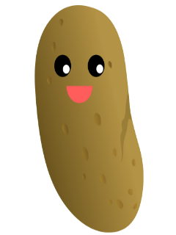

Sprint 2 Challenge:
Site hosting
https://grocerybuddy-fe337.firebaseapp.com
Edit affiliates
Take 2
Phoenix Recipes
iPicky
Easter egg

Slide 7
Task assignments:
Kevin - bug-fixing, assisting with database integration
Toni - bug-fixing, assisting with database integration
Raly - Structuring database, syncing client-side functions
Patrick - code port, Firebase integration, gestures
Carlo: easter egg implementation, notifications

Slide 8

Sprint 2 Scrumboard:
Click here!

Slide 9


Conclusion
THANKS!

